Slide 1


Welcome to English for Programming
Week 3 Class 1
<a href="https://storyset.com/people">Illustration by Freepik Storyset</a>

Slide 2

Objectives for today
By the end of the class, you will be able to…
Share your experiences in the previous Asynchronous Session
Learn and use colours and adjectives
Describe people and objects
Pronounce and identify long and short vowel sounds

Slide 3
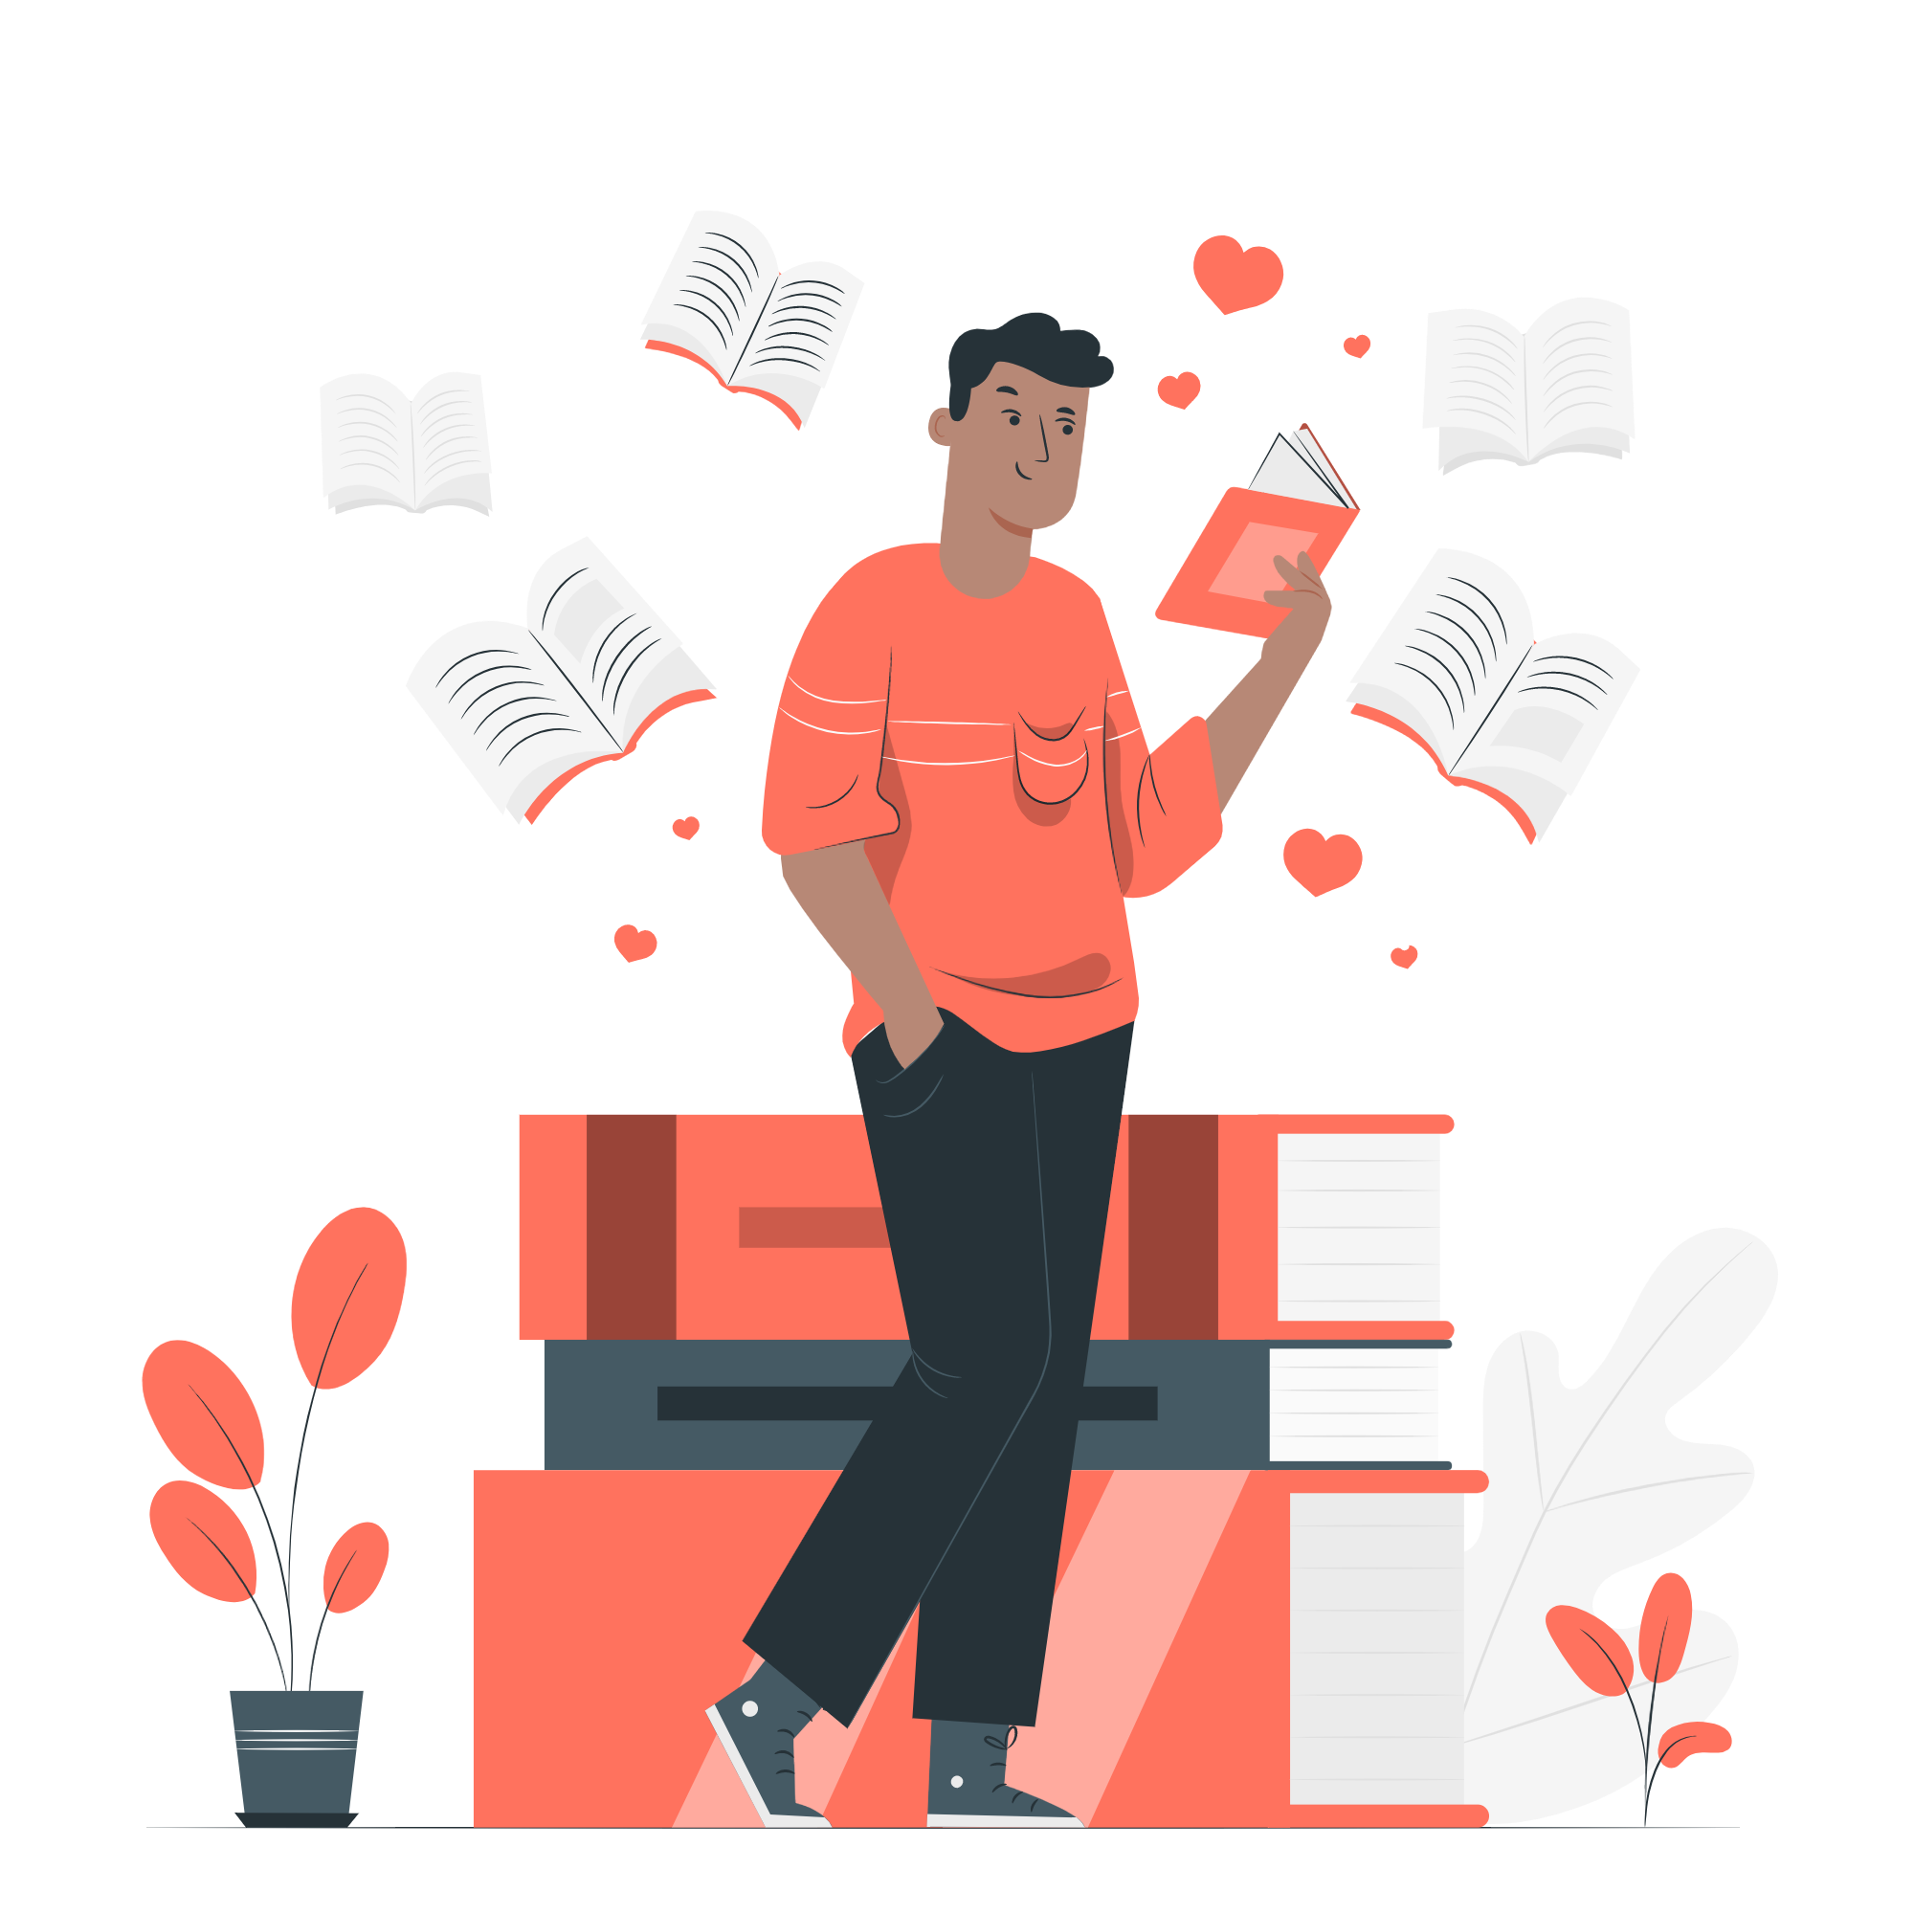
Tutorial – Review
What do you remember from the asynchronous session?
Mention at least 2 topics that you learned from the asynchronous session
are there questions regarding your individual work?
<a href="https://storyset.com/education">Illustration by Freepik Storyset</a>

Slide 4

Explore
Look at the following picture. Can you describe what you see?
Match the colour with the correct number:
Green ___
Grey ___
Brown ___
Purple ___
Red ___
Yellow ___
​
5
6
7
8
4
9
White ___
Orange ___
Blue ___
Light blue ___
Dark green ___
Black ___
3
10
2
11
1
12
Photo by Pixabay on Pexels
Listen and practice with this exercise:
https://agendaweb.org/exercises/vocabulary/colours/colours-audio
Notes:
Answers:
8
10
11
5
4
2
1
3
6
7
9
12

Slide 5
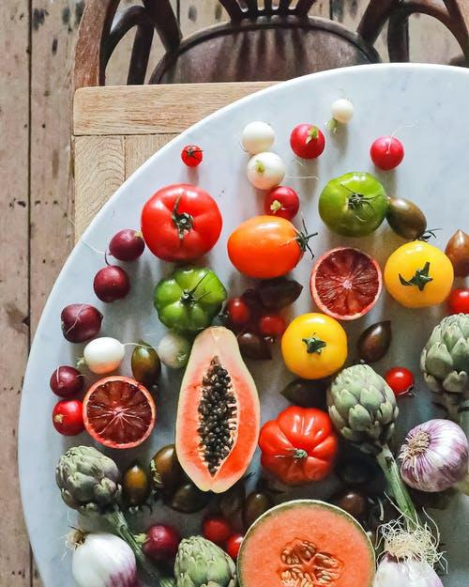
Explore
Look at the following picture. Can you describe what you see?​
Answer the following questions:
What´s your favourite fruit?
How often do you eat it?
What colours can you identify?
Photo by Geraud Pfiffer on Pexels

Slide 6
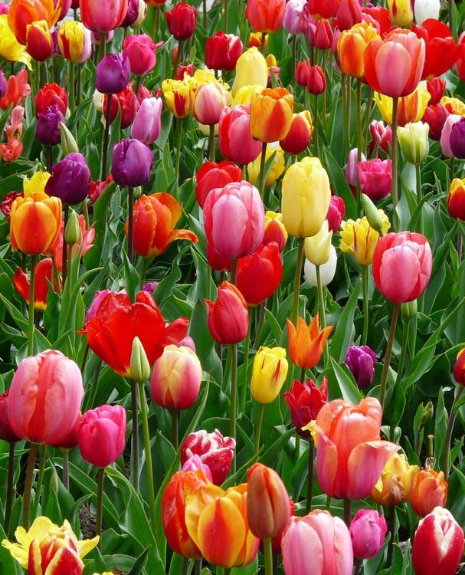
Explore
Look at the following picture. Can you describe what you see?​
Answer the following questions:
What´s your favourite flower/plant?
Do you have any flowers/plants at home?
What colours can you identify?
Photo by Pixabay on Pexels

Slide 7

Explore
Look at the following picture. Can you describe what you see?​
Answer the following questions:
What flag(s) can you recognize?
Which country would you like to visit?
What colours can you identify?
Photo by Gabby K on Pexels

Slide 8

Explore
1. Read the article HTML Colour Codes Theory. Pay attention to the words in bold and underlined.
HTML Color Codes Theory
HTML Codes format: Each HTML code contains symbol "#" and 6 letters or numbers. These numbers are in hexadecimal numeral system. For example "FF" in hexadecimal represents number 255 in decimal. Meaning of symbols: The first two symbols in HTML colour code represents the intensity of red colour. The third and fourth represents intensity of green and fifth and sixth represents the intensity of blue. So, with combining the intensity of red, green and blue, we can mix almost any colour that our heart desire ;)
With this HTML code: #FF0000 - we tell browser to show maximum of red and no green and no blue. The result is of course, pure red colour:
What’s your favourite colour?
Photo by This Is Engineering
Retrieved from: https://html-color-codes.info/

Slide 9
Check
1. Vocabulary. Read the text again and find the meaning of the underlined words.
Symbol
Letters
Numbers
Hexadecimal
System
First
Two
Fifth
Sixth
2. Match each of the ideas with the correct ending.
Each HTML code contains ___
The first two symbols in HTML colour code ___
With this HTML code: #FF0000 ___
So, with combining the intensity of red, green and blue, ___
we can mix almost any colour that our heart desire ;)
represents the intensity of red colour
symbol "#" and 6 letters or numbers
we tell browser to show maximum of red and no green and no blue
Notes:
Answers: 2 (1-d, 2-c, 3-b, 4-e, 5-a)

Slide 10
Discover
1. Look at the flowing sentences and select T for true or F for false for each statement below.
Each HTML code contains symbol "#" and 6 letters or numbers T F
HTML code contains numbers in hexadecimal numeral system T F
Combining the intensity of red, green and purple, we can mix almost any colour T F
Symbols in HTML colour code represents the intensity of any colour T F
2. Are you able to explain HTML colour coding? Write one sentences and discuss with your partners and teacher.
Notes:
Answers: 1. a. T b.T c. F d. purple isn’t correct F 2. it is only representing colours red, green and blue.

Slide 11
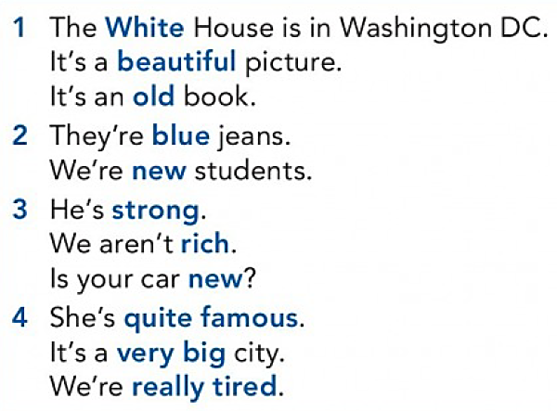
Language focus
Adjectives
4
Important Rules
Adjectives go before a noun
If an adjective begins with a vowel in an adjective + noun phrase we use an.
Adjectives don’t change before a plural noun
We use adjectives after the verb to be
We often use very, really, quite before adjectives

Slide 12
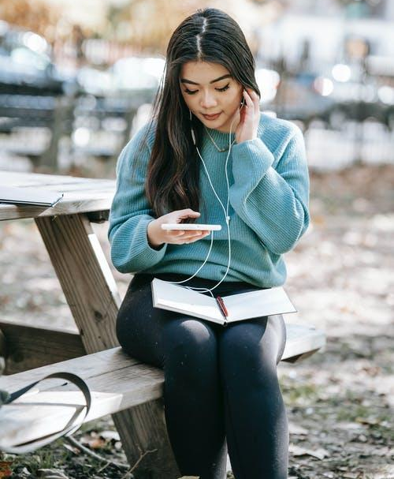
Practice
1. Scan the text, and find the antonyms of the adjectives underlined.
g. expensive
c. happy
d. Free
a. New
b. exhausted
e. old
f. dirty
2. Read the text and select the correct adjective options given
INTRODUCING V Plus 4.0
We all need the a. new/exhausted voice processing app V Plus 4.0. This new version is b. happy/very recommended. You can record your voice and edit it, using c. a/an automatic programme… Change your tone of voice with a single click .
The app V Plus 4.0 lets you browse d. frees/free options, customize tool bars, and eliminate e. old/dirty compatibility problems.
The app V Plus 4.0 f. expensive isn’t/ isn’t expensive, and you can
register for a 30 day free trial!
Photo by Charlotte May
3. Check your answers with your teacher and identify the rule in each case.
Notes:
Answers:
1. a. Old b. active/energetic c. sad d. expensive/costly e. young f. clean g. cheap
(a. New b. Very c. An d. Free e. Old f. isn’t expensive)
a. New – Rule: Adjectives go before a noun - b. very – Rule: We often use very, really, quite before adjectives – c. an – Rule: If an adjective begins with a vowel in an adjective + noun phrase we use an - d. Free – Rule: Adjectives don’t change before a plural noun – e. old – Rule: Adjectives go before a noun – f. isn’t’t expensive – Rule: We use adjectives after the verb to be

Slide 13
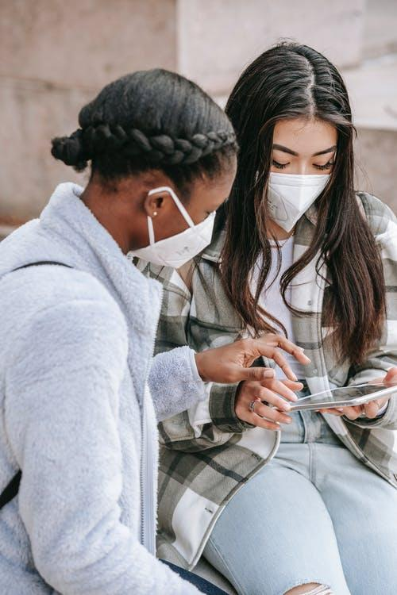
Practice
4. Put the words in the correct order.
4
a / app / very / useful
your / app / is / free / ?
the system / fast / isn’t / really
it / bad / a / app / is /?
price / cheap / is / the
Easy to use / app/ this/ an / is
5. Work in pairs/groups. Describe your favourite app using the following model:
My favourite app is______________. I like it because it has a/an____________ system. It is ______________ easy/difficult to use.
I recommend it because it is ______________
Photo by Charlotte May on Pexels
Notes:
Answers:
4. a) a very useful app. b) is your app free? c) The system isn’t really fast d) Is it a bad app? e) the price is cheap f) This is an easy to use app

Slide 14

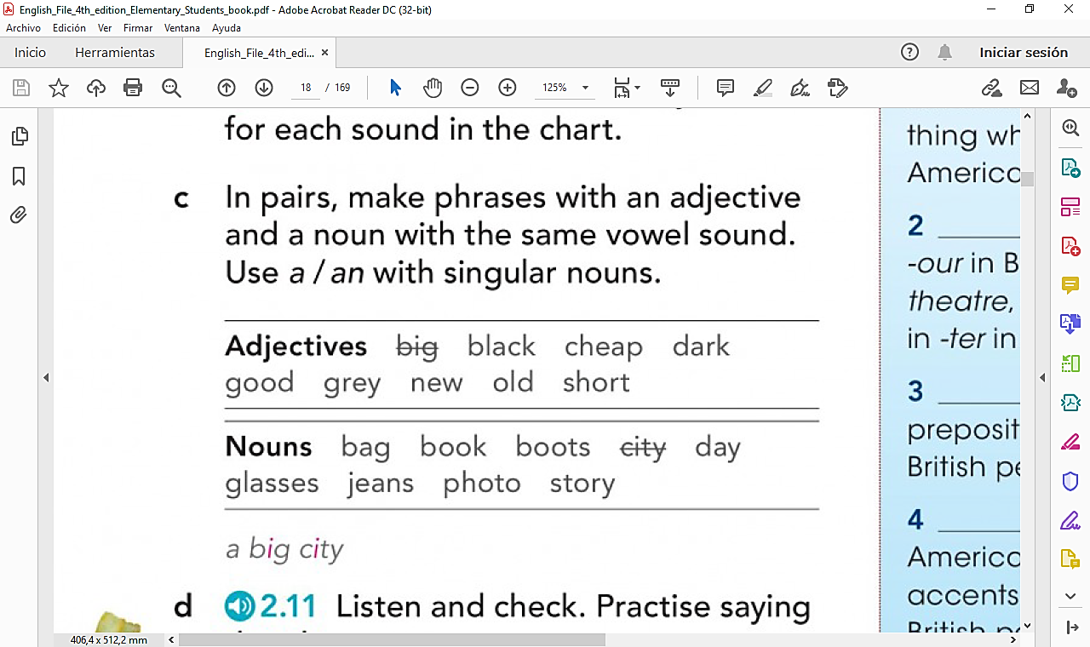

Practice
6. Make phrases with an adjective and a noun with the same vowel sound.
Use a/an with singular nouns.
Example: A big city.
4
7. Listen and check. Practise saying the phrases aloud.
Recording 2.11 New English File
<a href="https://storyset.com/education">Illustration by Freepik Storyset</a>
Notes:
Answers:
6. a) a black bag b. cheap jeans c. dark glasses d. good book e. grey day f. new boots g.old photo h. short story

Slide 15

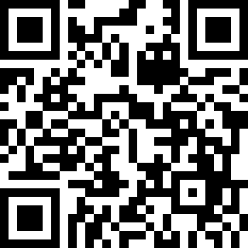
Vocabulary game
4
1. Scan the following code and practice vocabulary of strong adjectives!
2. Scroll down to listen to the pronunciation and repeat.
<a href="https://storyset.com/online">Illustration by Freepik Storyset</a>
Notes:
https://quizlet.com/_9r1it0?x=1jqt&i=3o8kis

Slide 16
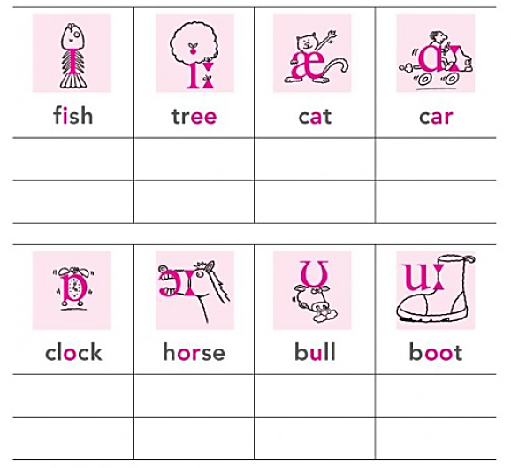
Pronunciation focus
4
1. Listen to the words and sounds.
2. Then listen and repeat. Which sounds are long?
Recording 2.9 New English File
The English vowels are pronounced in several ways.
The vowels are A, E, I, O, & U.
Sometimes Y is pronounced as I and W substitutes for U.
Notes:
https://quizlet.com/_9r3tmb?x=1qqt&i=3o8kis
Answer: 2. tree/car/horse/boot

Slide 17
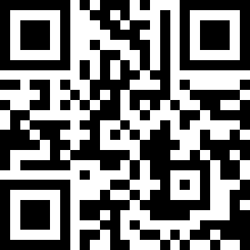
Pronunciation game
4
1. Scan the following QR code and practice long and short vowels!
2. Scroll down to listen to the pronunciation and repeat.
<a href="https://storyset.com/online">Illustration by Freepik Storyset</a>
Notes:
https://quizlet.com/_9r3tmb?x=1qqt&i=3o8kis

Slide 18
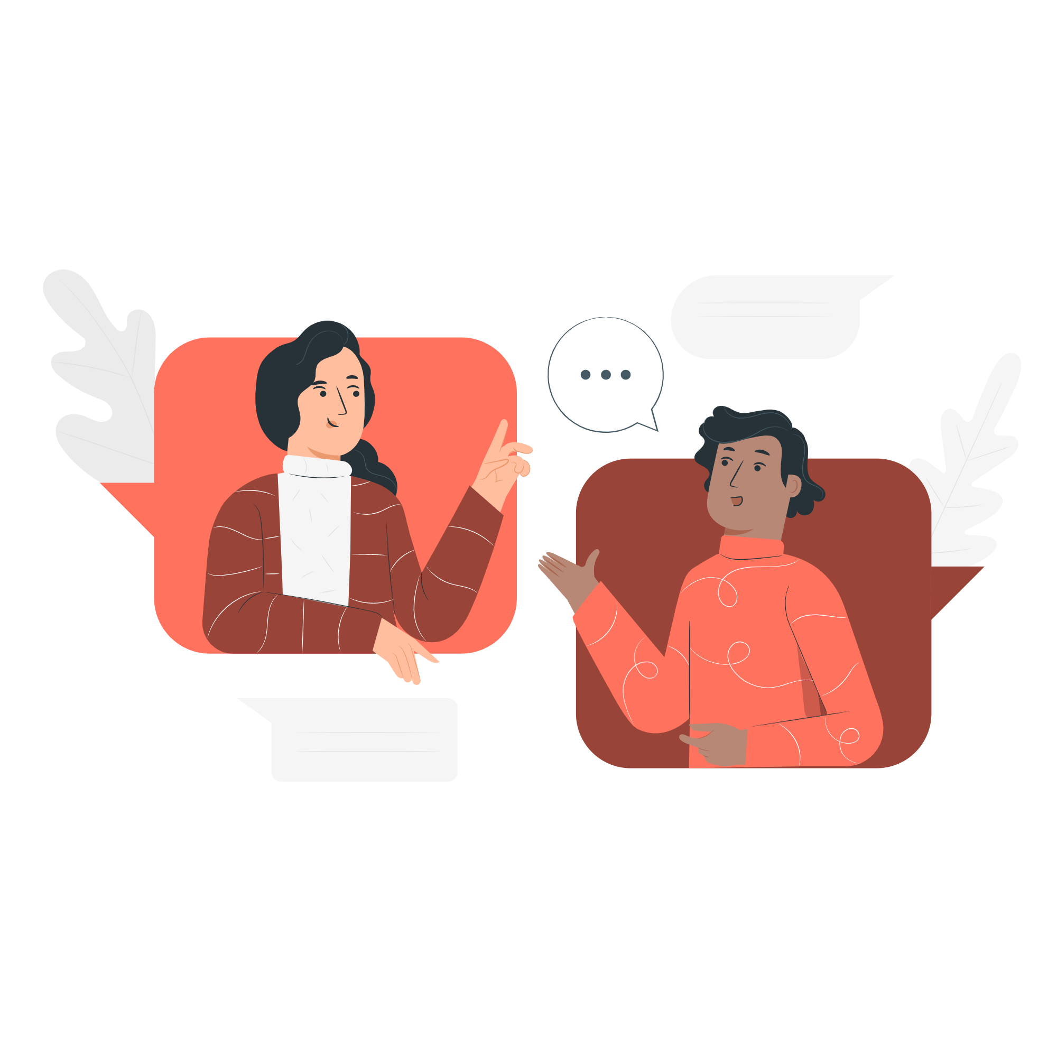
Practice
In groups or in pairs answer the following question.
Remember, you can use the topics studied in this and the past lessons.
4
Make a Decision!
You are asked to leave the planet today, and you can take only one object with you! Which tool or object would you take? Show us a picture and describe it. Then, explain your answer to your partners.
10 minutes
Recommendations
Take notes to organize your ideas and the vocabulary you need
Conversation Semi Flat Illustrations made by Storyset: https://storyset.com/illustration/conversation/pana
Listen to your partners carefully and try to understand their ideas
Ask questions to your partners or teacher if you need some help

Slide 19

Practice
Are you ready to play? Review the vocabulary and topics learned in class with this game.
Follow the instructions and have fun with your partners!
4
The Mystery Person/Object
Useful Expressions
1. All participants prepare individually the secret description of a person/object (4 mins)
Is he/she from Colombia?
Is it a technological device?
2. The group selects one person to start the game. He/she listens to the questions of the group. They have to ask yes/no questions only.
(3 minutes)
Is it expensive?
Is he/she famous?
3. Students need to guess the Mystery Person/Object in less than 2 to minutes.
If participants cannot guess, they lose their point.
Is it a modern invention?
Consulting Flat Illustration made by Storyset: https://storyset.com/illustration/consulting/rafiki

Slide 20


Reading Time!
Reading Strategy: Scanning
PEP 8
Style Guide for Python Code
Let’s go!
<a href="https://storyset.com/coronavirus">Illustration by Freepik Storyset</a>
Notes:
Se puede crear una ruleta con números con el fin de seleccionar el grupo al azar. Página sugerida https://www.online-stopwatch.com/random-name-pickers/name-picker-wheel/?r=dice

Slide 21
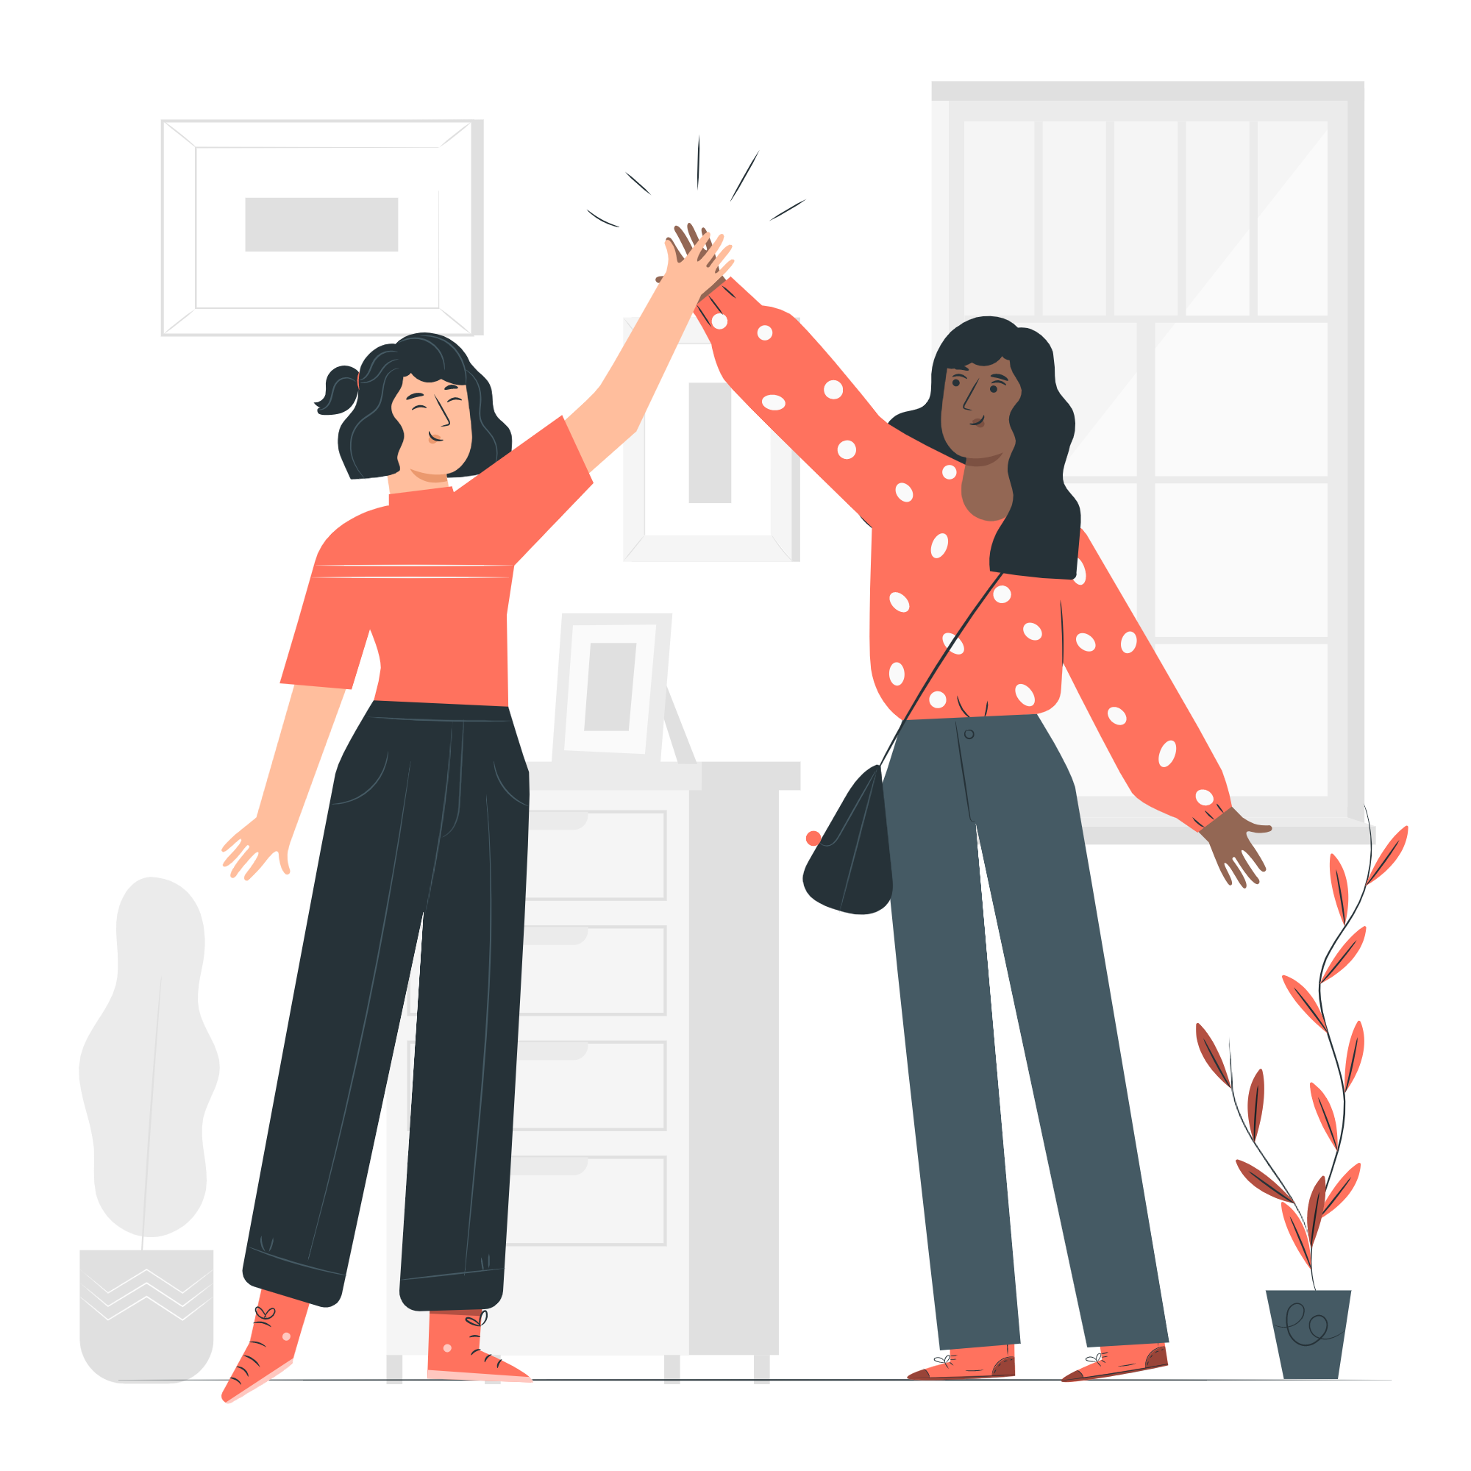
Explore!
4
Read the following information. Have you ever used scanning before?
Scanning is a strategy to read a text quickly in order to find specific information.
Example: you need to know the specific number of people that are using Python around the world… So, when you scan the text, you have this question in your mind and you read the passage only to find the answer.
Follow these steps to scan any text:
What’s your question? Make sure you know what you are looking for
Look through the text to find specific info: keywords, numbers and phrases
Scan the title, subtitles and abstract to see relevant content
Friendship Semi Flat Illustrations made by Storyset: https://storyset.com/illustration/friendship/pana
You have 25 minutes to work in your groups.
Notes:
Guide: W3C1_Reading_ Student_Worksheet

Slide 22
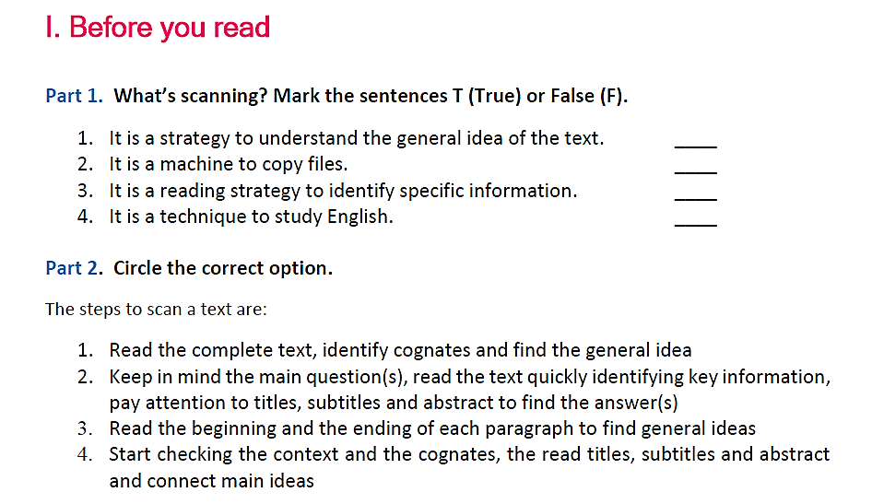
Reading Time!
Notes:
Guide: W3C1_Reading_ Student_Worksheet
Part 1 Answers: 1. F 2. F 3. T 4. F
Part 2 Answer: 2

Slide 23
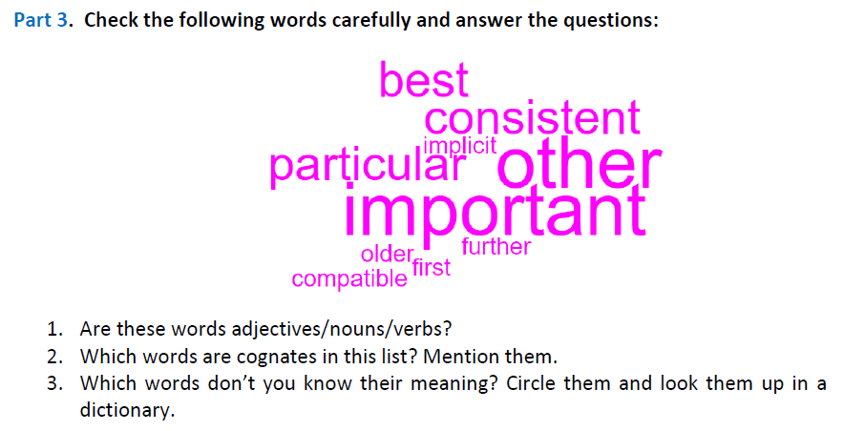
Reading Time!
Notes:
Part 3 Answers: 1. Adjectives 2. Consistent/ particular / important / implicit/ compatible 3. Answers may vary.

Slide 24
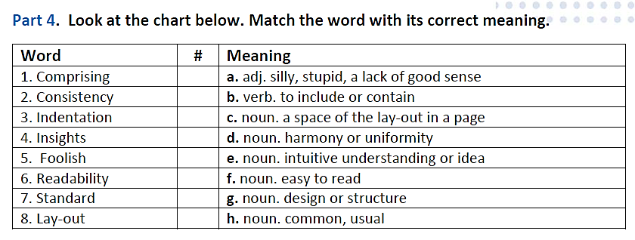
Reading Time!
Notes:
Part 4 Answers: 1. d 2. d 3. c 4. e 5.a 6. F 7.h 8. g

Slide 25
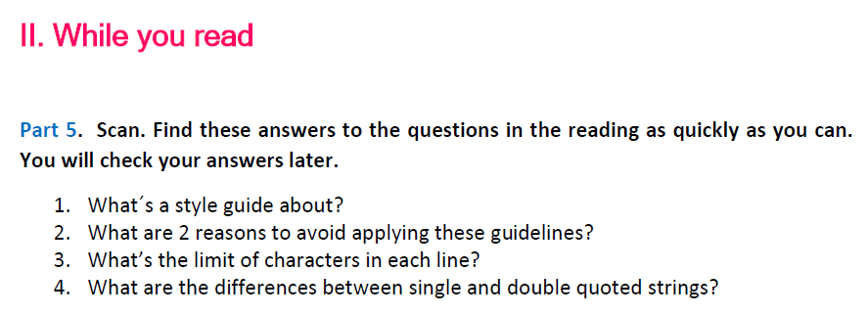
Reading Time!
Notes:
Part 5. Answers:
1. style guide is about consistency
2. When applying the guideline would make the code less readable, even for someone who is used to reading code that follows this PEP.
To be consistent with surrounding code that also breaks it (maybe for historic reasons) -- although this is also an opportunity to clean up someone else's mess (in true XP style).
Because the code in question predates the introduction of the guideline and there is no other reason to be modifying that code.
When the code needs to remain compatible with older versions of Python that don't support the feature recommended by the style guide.
3. Limit all lines to a maximum of 79 characters.
4. In Python, single-quoted strings and double-quoted strings are the same

Slide 26
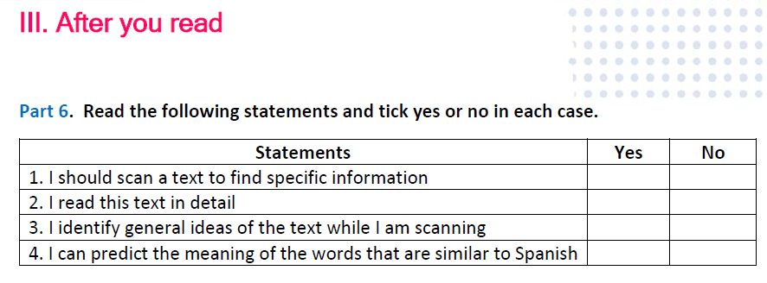
Reading Time!
Notes:
Part 6. Read the following statements and tick yes or no in each case. Statements
1. I should scan a text to find specific information YES
2. I read this text in detail NO
3. I identify general ideas of the text while I am scanning NO
4. I can predict the meaning of the words that are similar to Spanish YES

Slide 27
Wrap up!
To finish this session, think about your questions and what you learned!
4
STOP!
GO!
What I need to study more
What I Know
Notes:
Ss think about the questions and the topics of the lesson that they would like to reinforce, and put them on STOP. Then Ss think about the topics that they learned and place them on GO!

Slide 28
Thank you!

